Slide 1
Aarav Artham Portfolio

Slide 2
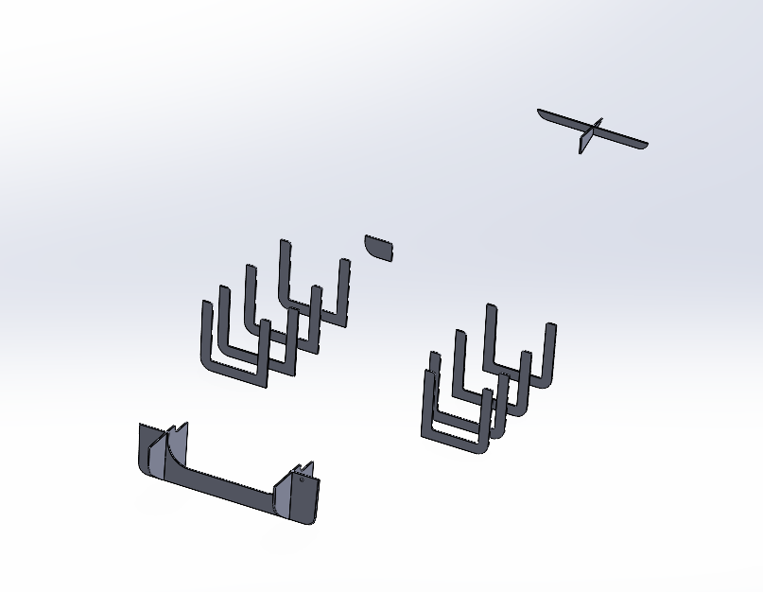
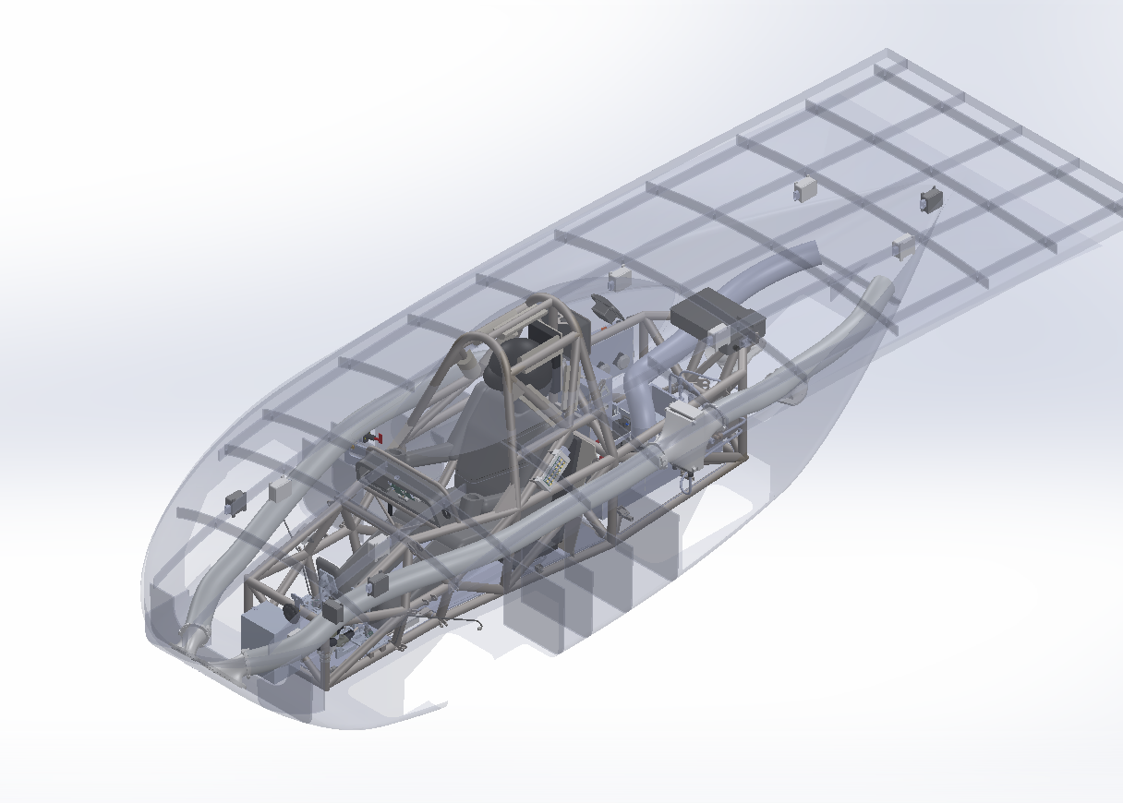
Composite Bulkhead Aeroshell Design LHR Solar
Skills
ANSYS
Composite structures
Aeroshell design
Bulkhead architecture
Sandwich panels
Ply layups
Fiber orientation
Laminate design
Structural skins

Slide 3
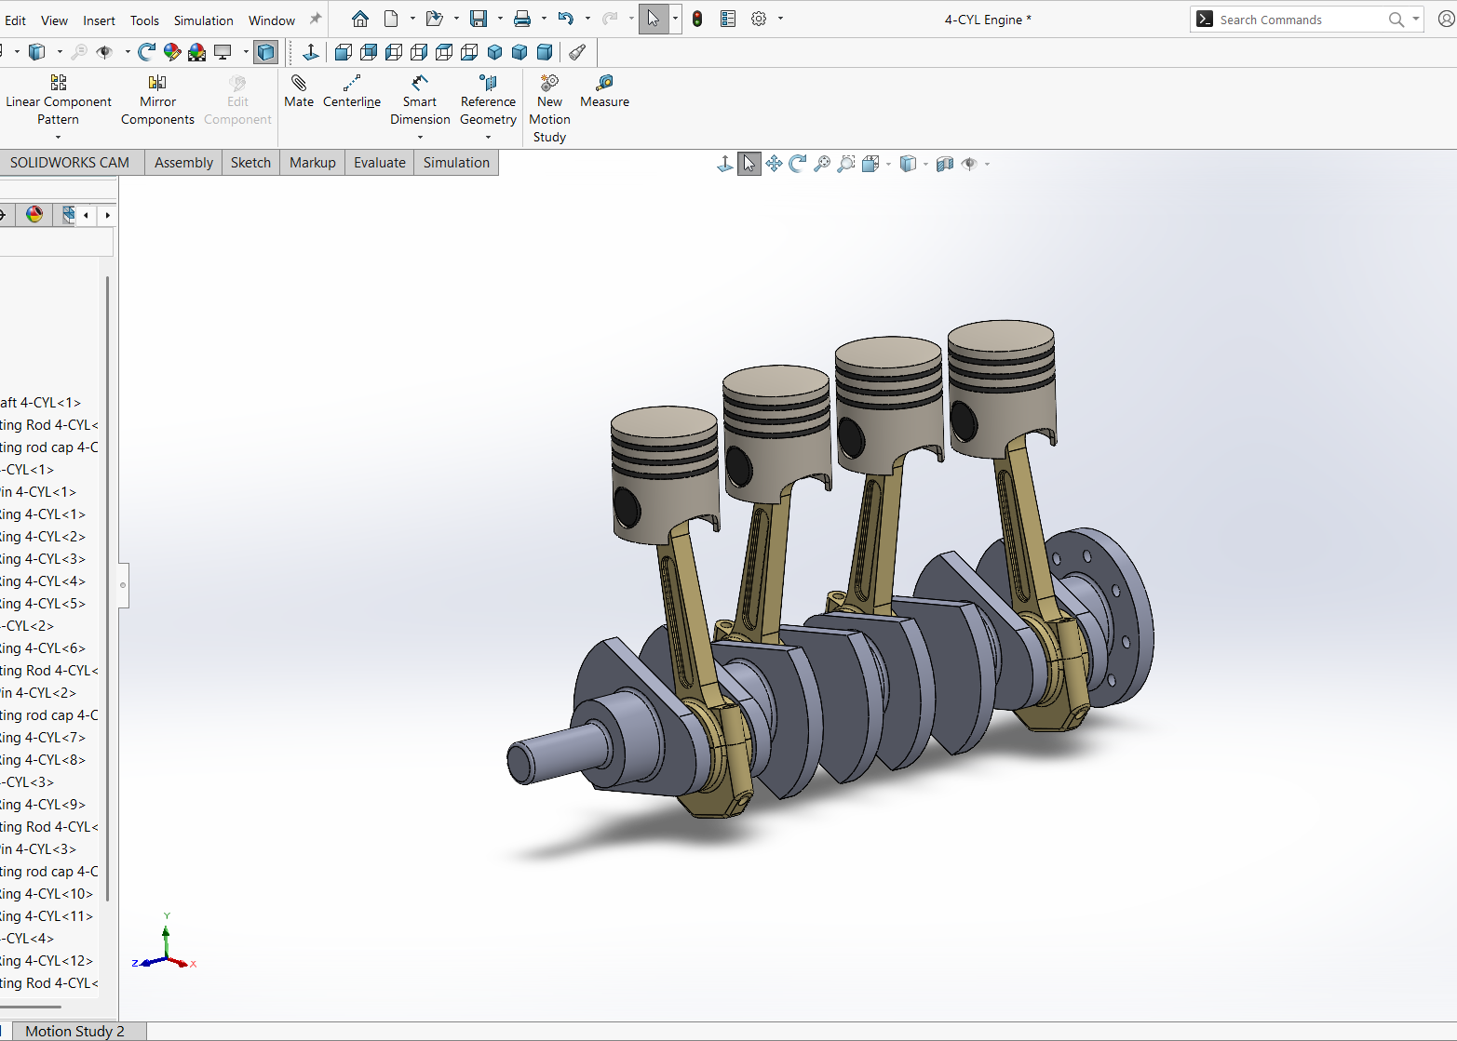
4 Cylinder engine
Skills
Engine assembly
Precision measurement
Tolerance control
Component fitting
Rotating assemblies
Crankshaft alignment
Piston installation
3D Printing

Slide 4
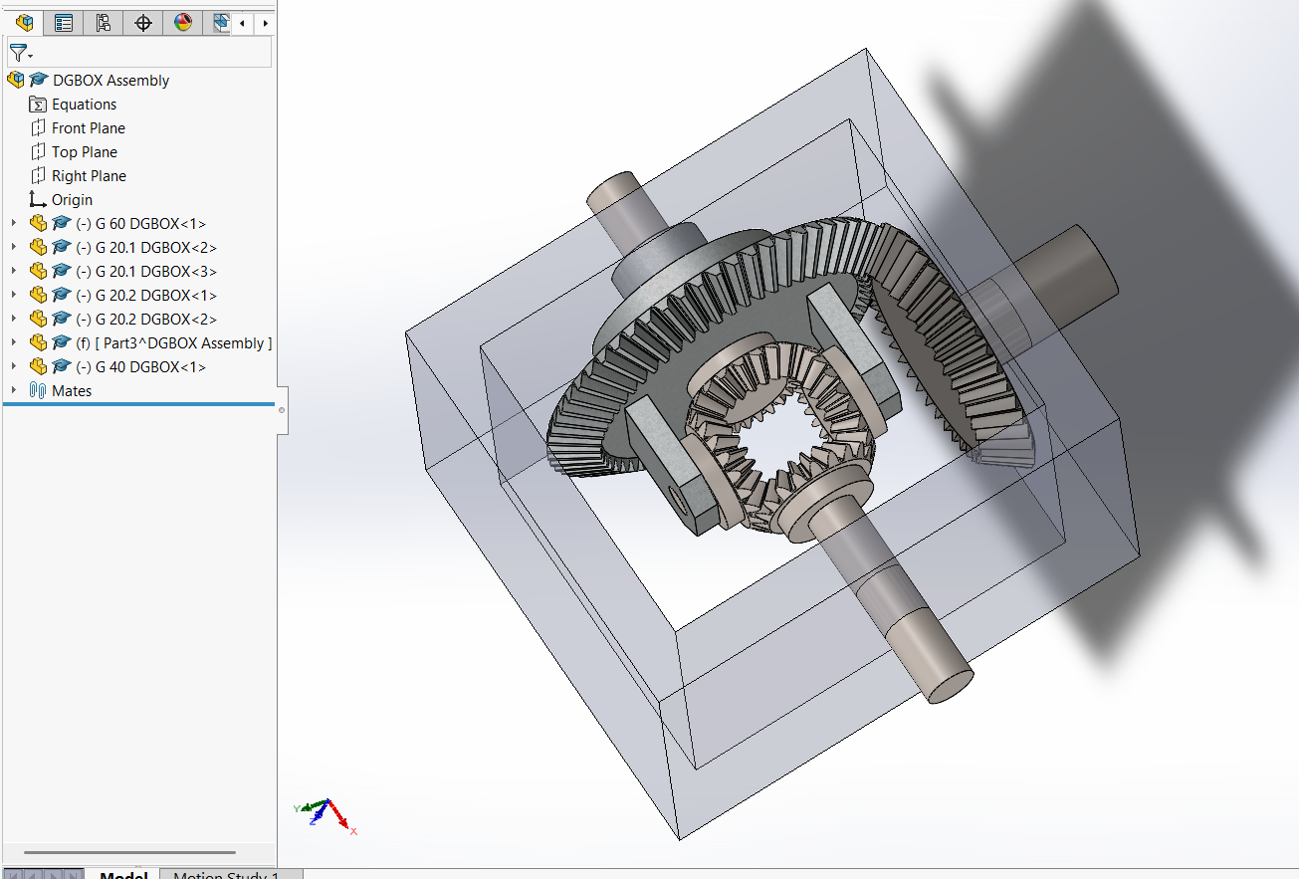
Differential Gearbox
Skills
Tolerance control
Component fitting
Rotating bevel gear assemblies
Piston installation
3D Printing

Slide 5
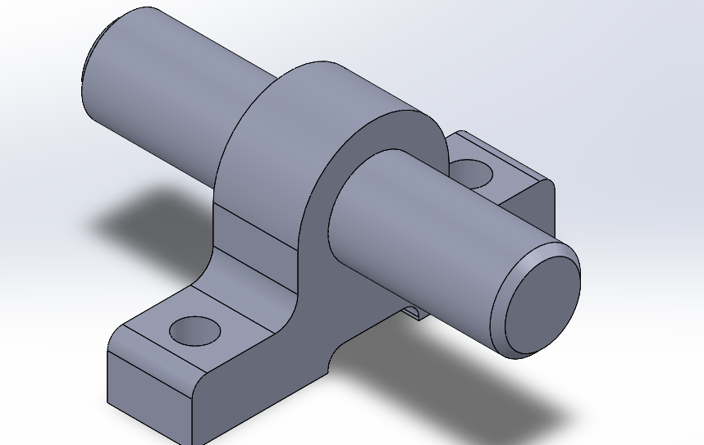
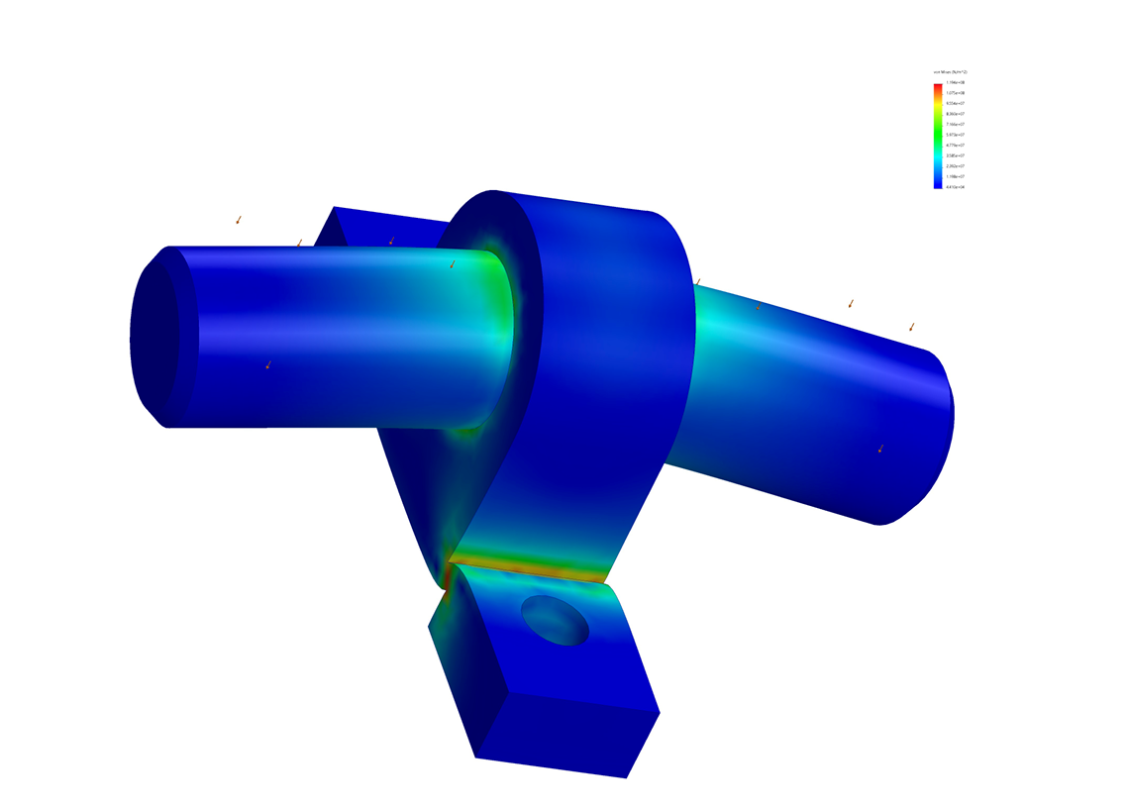
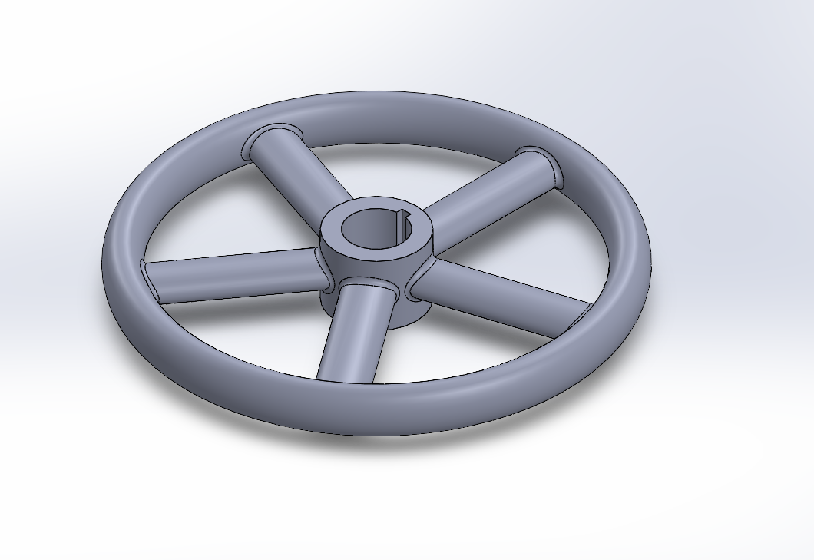
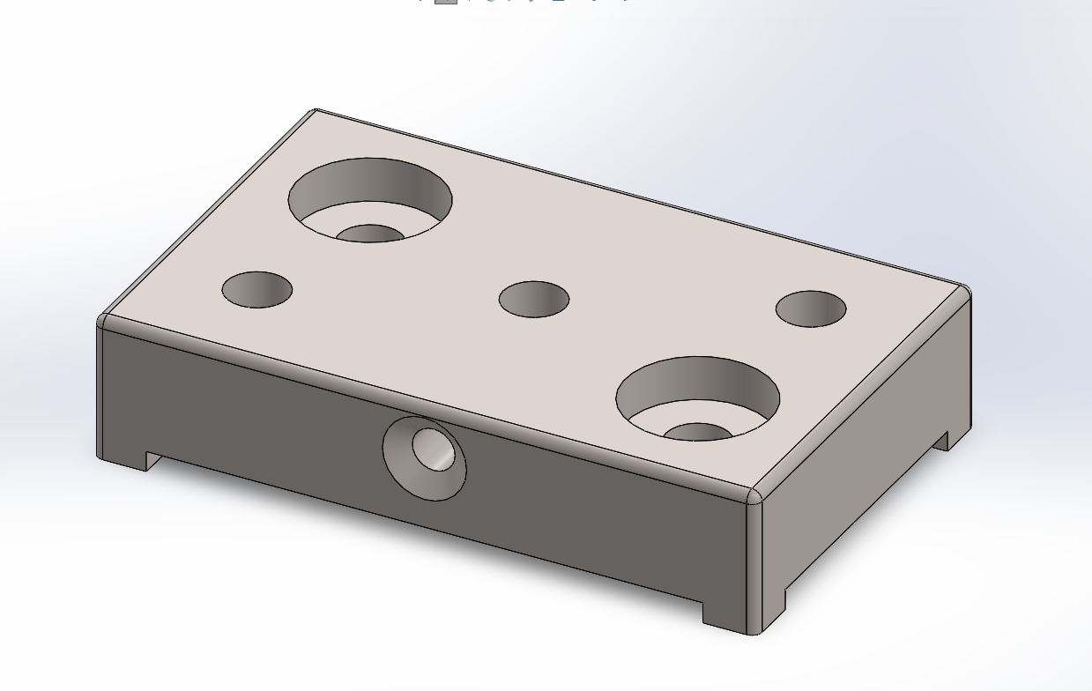
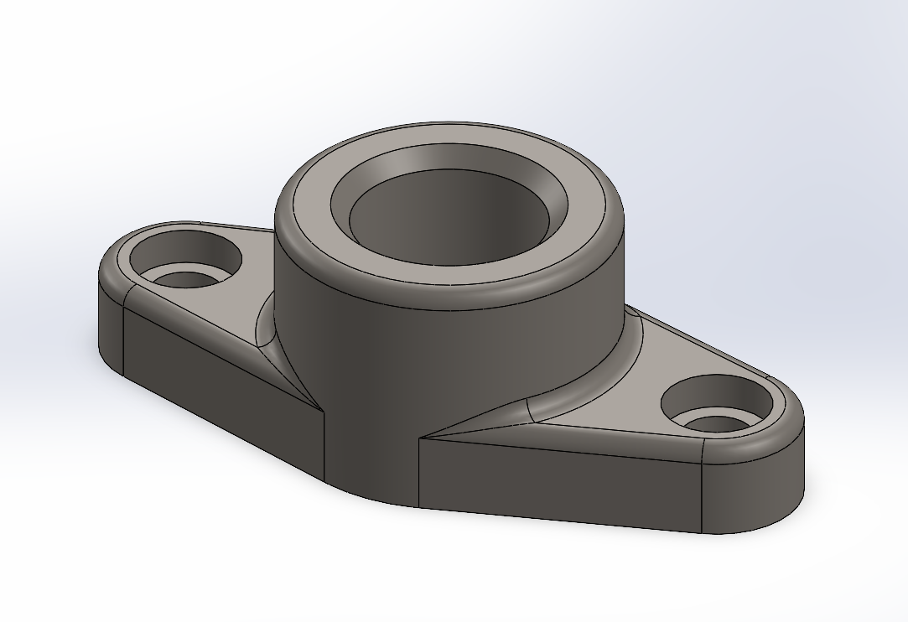
CAD Design
Skills
Tolerance control
Component fitting
Hole wizard
Intersection curves
3D Printing
SolidWorks FEA
Pillow Block Assembly
Pillow Block Assembly FEA SolidWorks
Hand Wheel
Tooling Pad
Pipe Joint

Slide 6
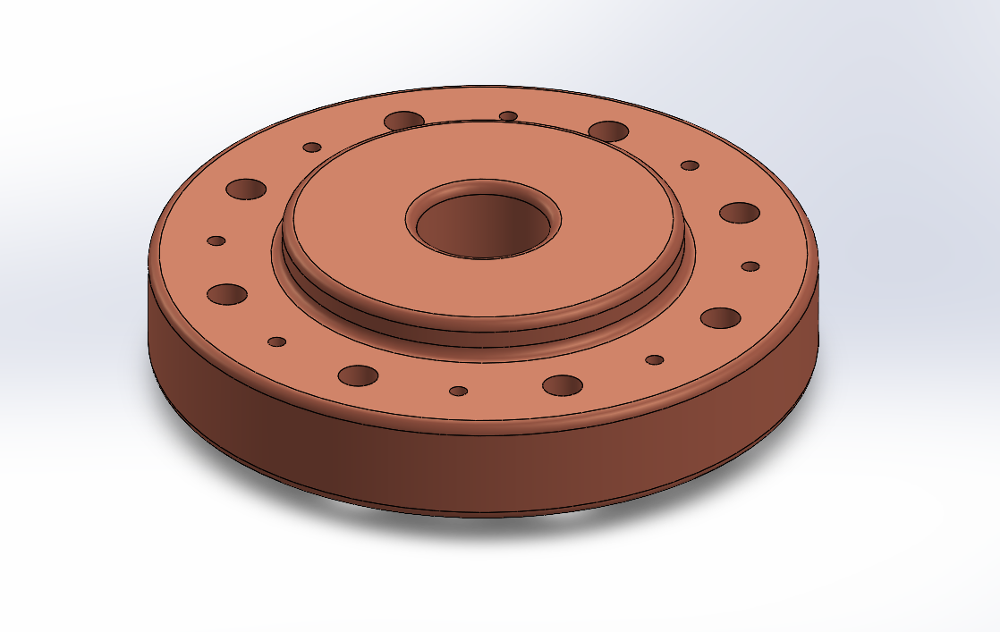
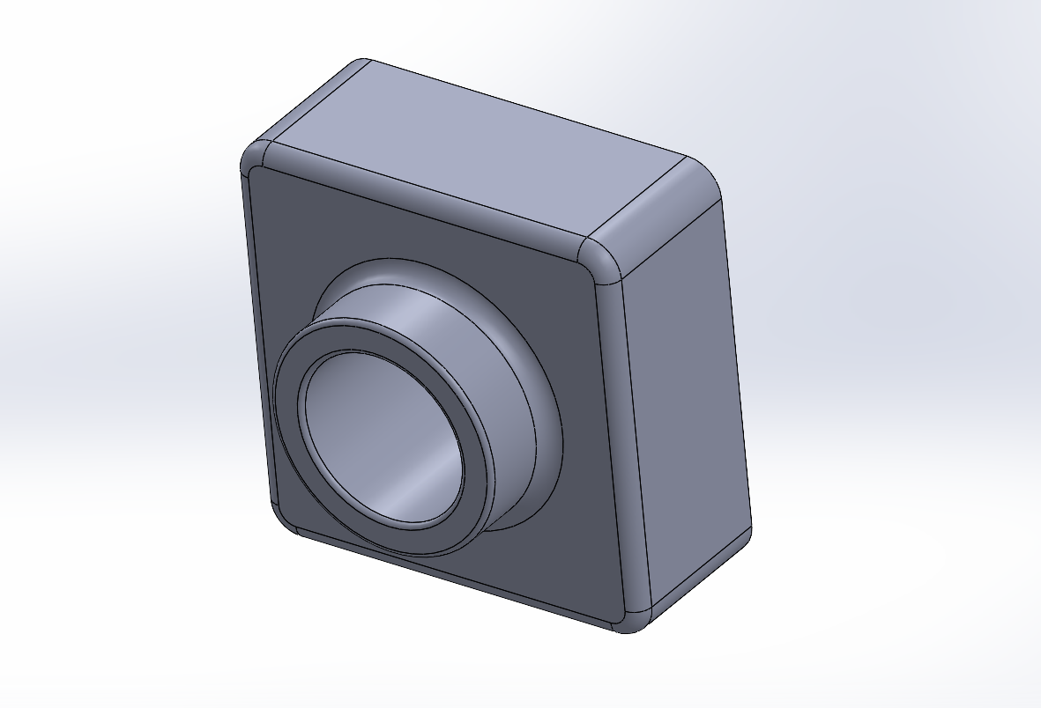
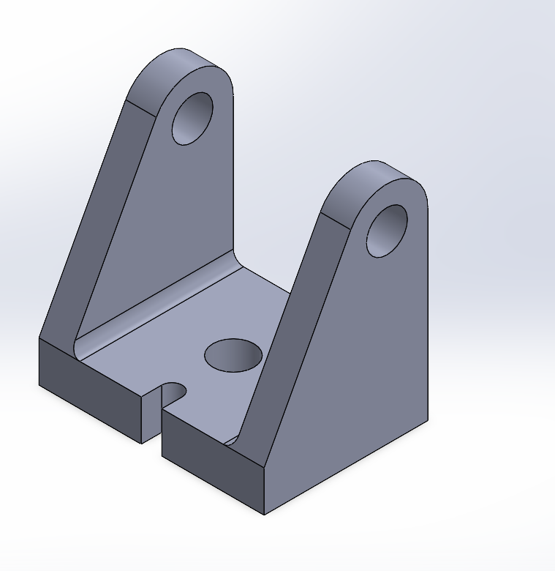
CAD Design
Skills
Tolerance control
Component fitting
Hole wizard (screws and bolts)
Intersection curves
3D Printing
Pedestal Base
Pillow Block Assembly FEA
Mounting Bracket

